Slide 1
The presentation of the 3 relational DBMS:
MySQL, PostgreSQL, SQL SERVER .

Slide 2
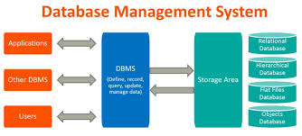
What is Relational Database Management System?

Slide 3
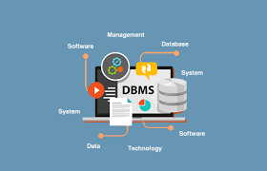
It’s a software application used to create ,manage and administer the Relational Database

Slide 4
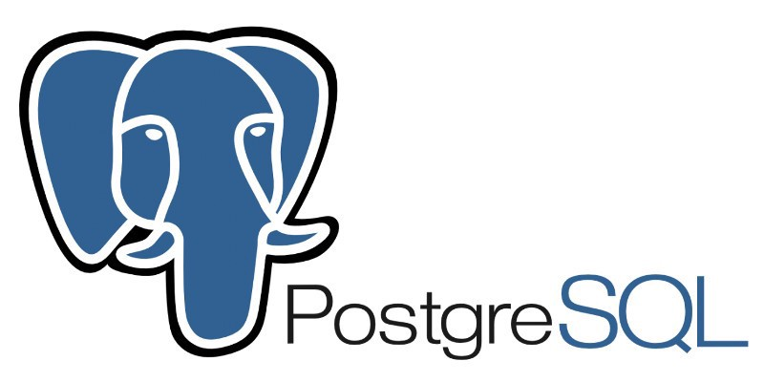
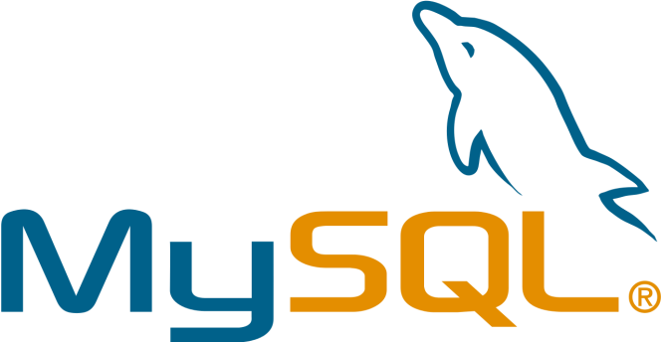
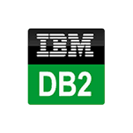
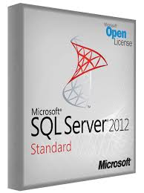
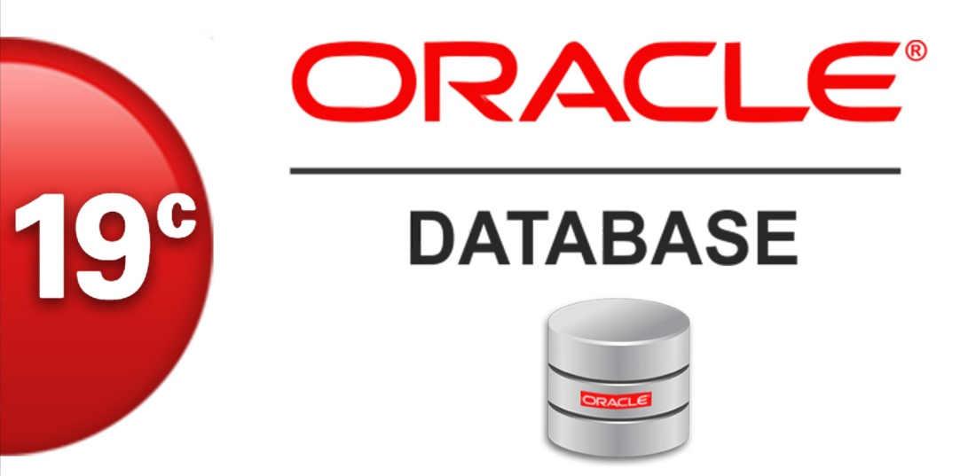
*The most commonly used relational database management systems include:

Slide 5
We are going to present the most 3 well known relational RDBMS :
-MYSQL
-PostgreSQL
-SQL SERVER

Slide 6
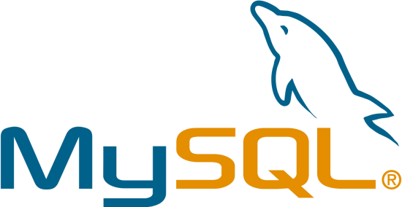
1. WHAT IS MYSQL?
It’s a very popular open source relational database management system
Uses SQL(Structured Query Languages)
It’s a leading database for web applications
It’s used in small business websites all the way to very large scale entreprise applications.
You can use it for just about anything,it’s used with multiple languages which are used in web development like:PHP,NodeJs,Phython..
It’s completely cross-platform ,so you can install it on Linux which is probably what you are going to use in production but also you can install it on your Windows or Mac

Slide 7
MySQL uses a client-server model
It’s powered by the oracle corporation
It is a freely available database system.
It provides multiuse access to support many storage engins.
It sotres data in tables
It provides you fast loading utilities with different memory cache

Slide 8

2.PostgreSQL
It’s a free and open source object-relational database system
It supports both SQL (relational) and JSON (non-relational) querying.
It’s used as the primary data store for many web, mobile, geospatial, and analytics applications.
*The common use cases of PostgreSQL:
- A robust database in the LAPP stack: PostgreSQL is primarily used as a robust back-end database that powers many dynamic websites and web applications.

Slide 9
General purpose transaction database: Large corporations and startups uses PostgreSQL to support their applications and products.
Geospatial database:PostgreSQL supports geospatial databases for geographic information systems through PostGIS
*Programming languages supported by PostgreSQL:
Python, Java, C#, JavaScript (Node.js), Ruby, C/C+, Perl, Go, Tcl

Slide 10
*Features of PostgreSQL
It’s is designed to be extensible
It allows you to define your own data types, index types, functional languages,
It’s sophisticated locking mechanism
It’s asynchronous replication
*Who uses PostgreSQL?
Many companies have built products and solutions based on PostgreSQL like Apple, Fujitsu, Red Hat, Cisco, Juniper Network, Instagram

Slide 11
3.SQL SERVER
It’s a relational database management system
from Microsoft that supports a variety of applications in corporate IT environment from transactions processing to business intelligence analytics .
It’s a database server that implements the Structured Query Language (SQL)
It stores and retrieves data requested by other applications.
It works on Windows and Linux OS

Slide 12
*Features of SQL server :
-Availability
-Performance
-Security

Slide 13
The comparaison between the 3 RDBMS
PostgreSQL and MySQL are time-proven solutions that can compete with enterprise solutions such as Oracle and SQL Server.
SQL Server is a database management and analysis system for e-commerce, line-of-business, and data warehousing solutions.
The MySQL software delivers a very fast, multi-threaded, multi-user, and robust SQL (Structured Query Language) database server. MySQL Server is intended for mission-critical, heavy-load production systems as well as for embedding into mass-deployed software.

Slide 14
PostgreSQL is an advanced object-relational database management system that supports an extended subset of the SQL standard, including transactions, foreign keys, subqueries, triggers, user-defined types and functions.

